Slide 1
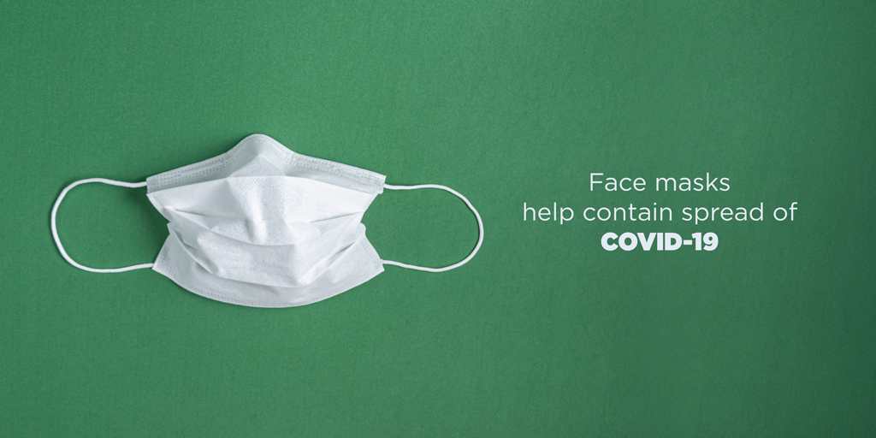
Covid-19 Challenge (CC)

Slide 2
supervisors
Dr. Rasha Orban
Eng. Noha Abdelkareem

Slide 3
Project team
Ahmed Ayman Ahmed Ahmed
Amgad Saber Gaber Esmail
Bassam Mohamed Ghoneimy Elabassy
Eslam Ashraf Abdul-Razeq Hassan Elsawy
Hazem Moahmmed Abbas Sayed
Osama Mohammed Abdelfattah

Slide 4
agenda
Introduction
Problem definition
Motivation
Implementation
Project Demo
Conclusion
Future work
Tools & Libraries
Resources

Slide 5
introduction
The novel Coronavirus has brought a new life in which social distancing and wearing face masks play a vital role in controlling the spread of the virus. But most people do not wear face masks in public, which increases the spread of viruses. This could lead to a serious problem of further spread. Hence to avoid such situations, we have to scrutinize and make people aware of wearing face masks. Humans cannot participate in this process, due to the chance of getting affected by corona. Hence the need for Artificial Intelligence (AI), which is the main theme of our project.

Slide 6
Problem Definition
Because of the precautionary measures and the changes in the education system in Egypt, students of the faculties from departments cannot get the lectures in the faculty because of applying the precautionary measures so that they have to study from the books with the photos in it without seeing the code, also after the quarantine students cannot get closer to each other to see what the lecturer say to not help in the spreading of Covid-19 (Corona Virus). Also, if the students enter in separated groups this will take a lot of time and efforts from the lecturers to finish the lectures. So, we decided to make detecting the people without mask easier and provide this project to can help in it.

Slide 7
Motivation
In 2020 the world got a disaster called Covid-19 (Corona virus) that came on the whole world and continued in spreading till now, so that many several countries changed the educational system to the online learning to Applying precautionary measures. But many faculties got affected in their educational level because it is a surprising disaster. This motivated us to create an application that contributes and helps in applying precautionary measures and curbing that virus by following up and alerting people to take the necessary measures and wear a mask.

Slide 8
Implementation
Related work.
System Architecture.
Dataset(Face Mask Detection).
YOLOv5 (Architecture).
YOLOv5 (Result).
Faster R-CNN (Architecture).
SSD (Architecture).
Desktop Application(Covid-19 Challenge).

Slide 9
Related work
Reference | Algorithm | Algorithm techniques | Dataset | Accuracy
[1] C. Szegedy et al. | YOLO | Residual blocks. Bounding box regression. Intersection Over Union (IOU). NMS (Non-Max Suppression). Anchor box. | Dataset consists of 2163 images containing three different modes of precautionary measures. There are people wear mask correctly, not wear mask, wear mask incorrectly. | 91%
[2] Girshick, Ross. | Faster R-CNN | Bounding box regression. SVM for object classification. Feature extraction from Region Proposals. | Dataset preparing by labeling to each mode (With-Mask, Without-Mask, Incorrect-Mask) by use bounding box to face and naming it based on the state. | 88%
[3] Zeiler, Matthew D., and Rob Fergus. | SSD | Extract feature maps. Apply convolution filters to detect objects. | Dataset splitting into (train 70%,valid 20%,test 10%) | 86%

Slide 10
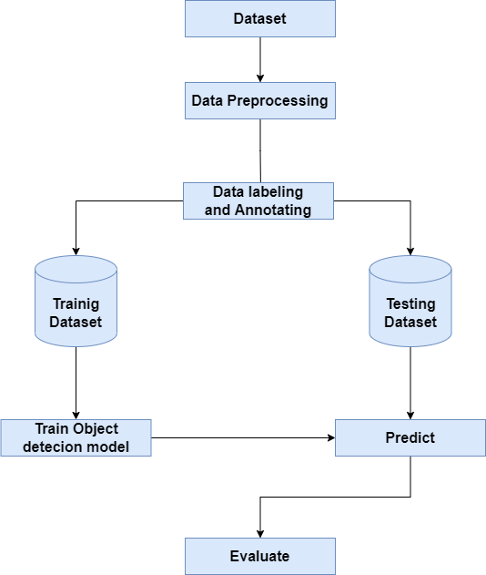
System architecture

Slide 11
Implementation
Dataset(Face Mask Detection)

Slide 12
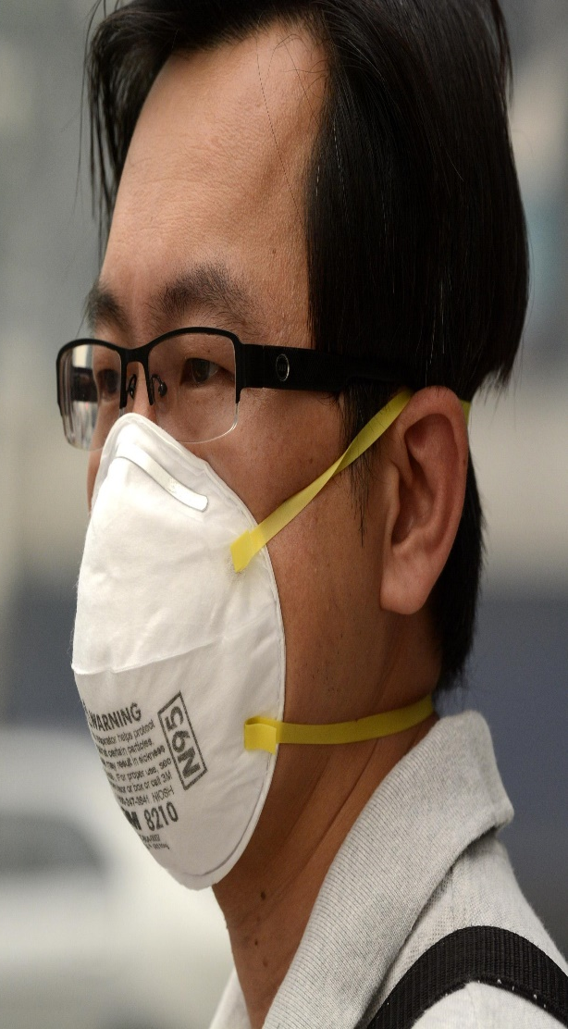
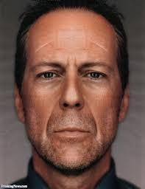
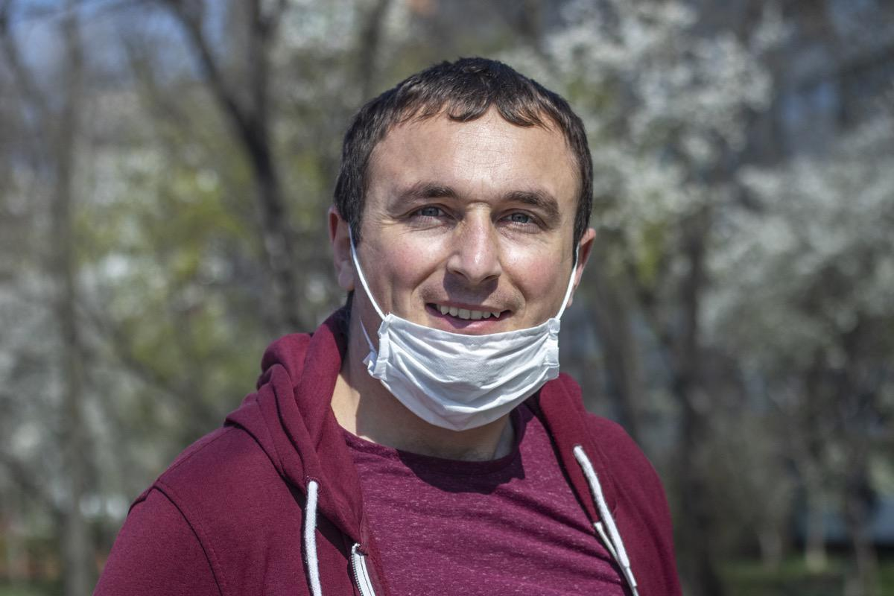
Dataset collection
contains images of three different modes of precautionary measures. (wear mask correctly, not wear mask, wear mask incorrectly.). The dataset has a total of “2163” images, Divided to three categories (With-Mask, Without-Mask, Incorrect-Mask).

Slide 13
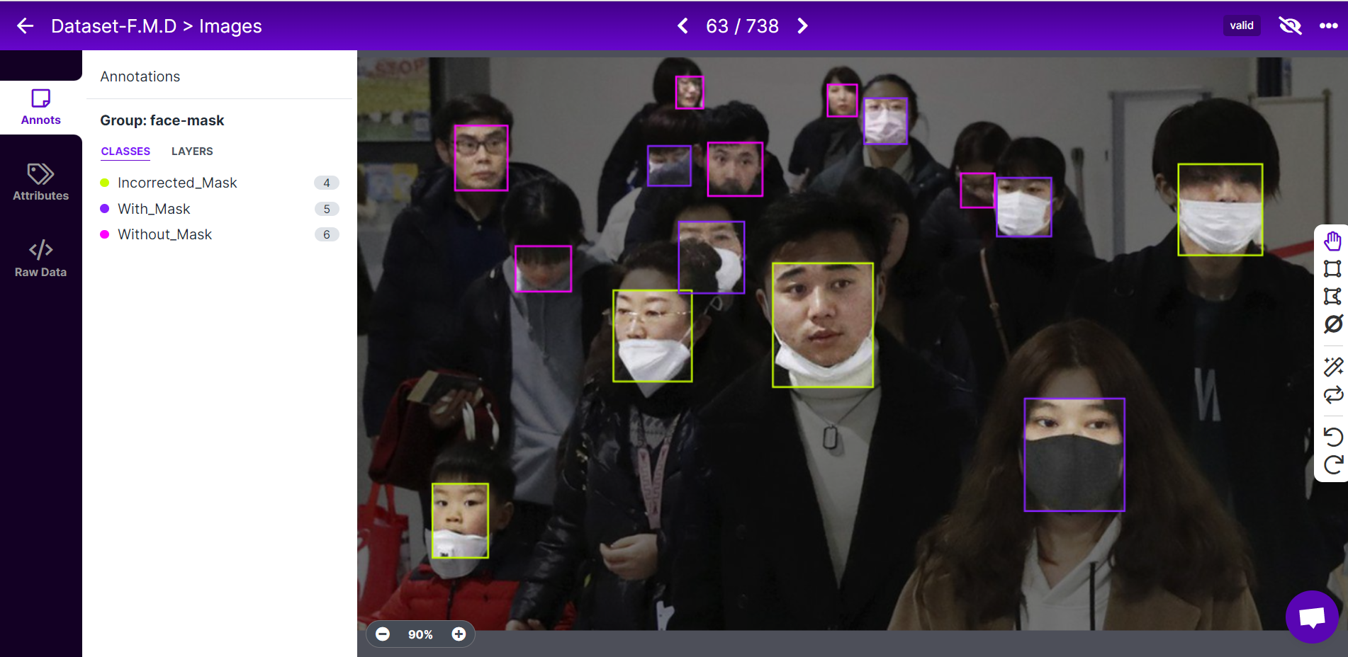
dataset Pre-processing
Bounding Box: is an imaginary rectangle that serves as a point of reference for object detection and creates a collision box for that object. Bounding boxes are one of the most popular image annotation techniques in deep learning. Compared to other image processing methods, this method can reduce costs and increase annotation efficiency.
Labeling: is to identify the type of class of the bonding box that has been drawn.

Slide 14
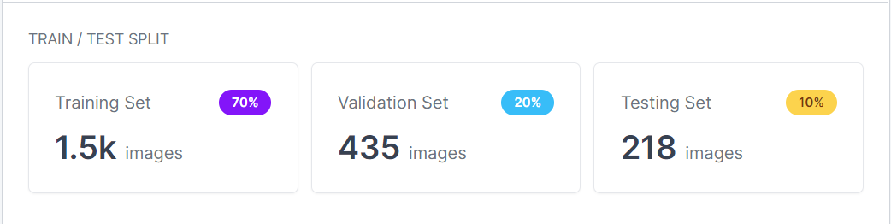
Dataset splitting
Divide the dataset by giving the appropriate proportions for use in our models as follows:
(training 70%,
validation 20%,
testing 10%)

Slide 15
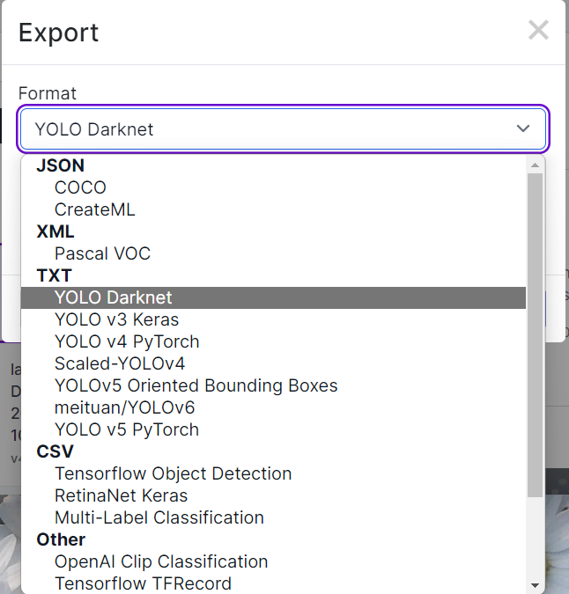
Dataset extensions
The type of dataset extension is a matter that varies according to the type of model required to be filled with dataset; we used a Roboflow to choose the appropriate extension for each model.

Slide 16
Implementation
YOLOv5

Slide 17
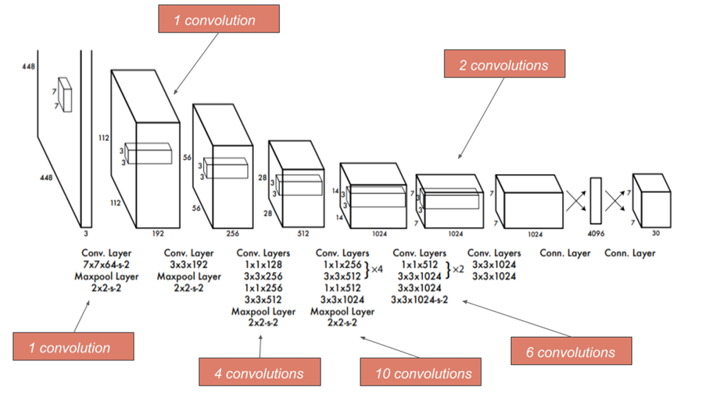
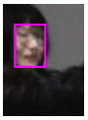
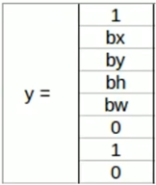
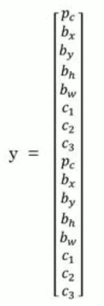
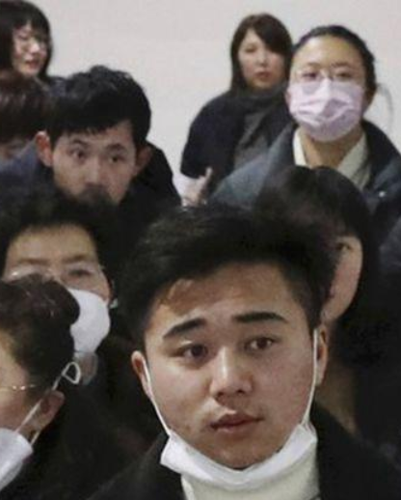
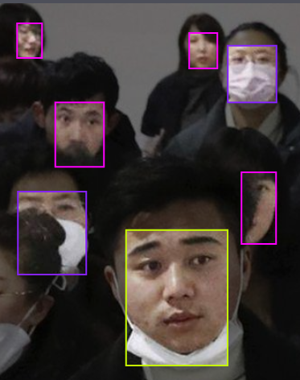
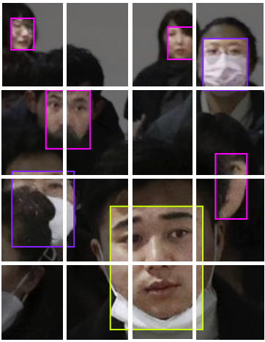
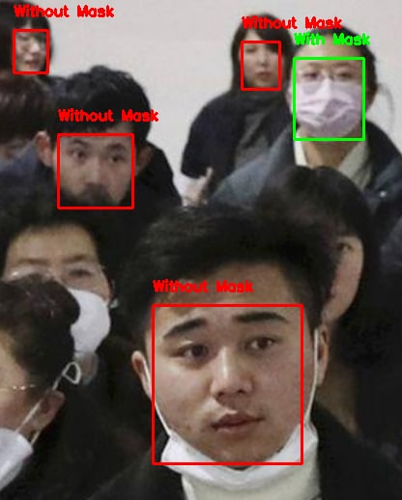
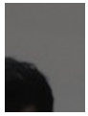
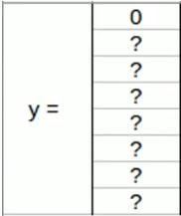
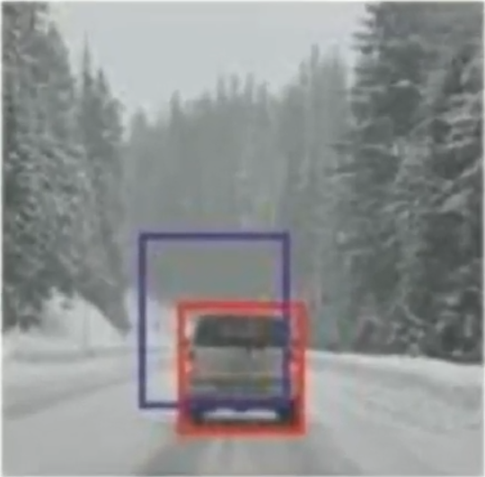
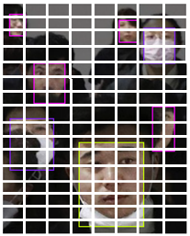
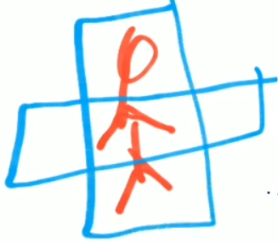
YOLOv5 (Architecture)
The Architecture. Our detection network has 24 convolutional layers followed by 2 fully connected layers. Alternating 1×1 convolutional layers reduce the features space from preceding layers.
Algorithm Techniques:
Residual blocks.
Bounding box regression.
IOU (Intersection Over Union):[0:0.5:1].
NMS (Non-Max Suppression).
Anchor box.
Input
Output
Image
+
Label
Total features
To total objects
In one image
IOU
NMS
Anchor box

Slide 18
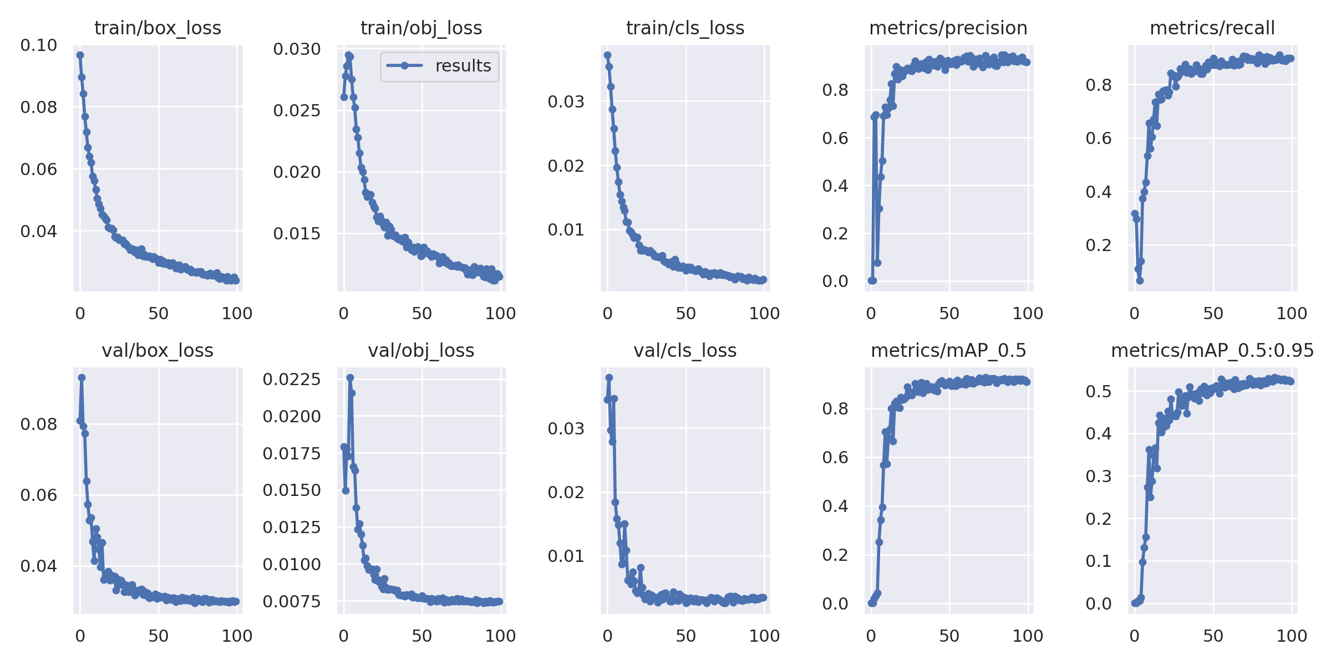
YOLOv5 (Result)

Slide 19
Implementation
Faster R-CNN

Slide 20
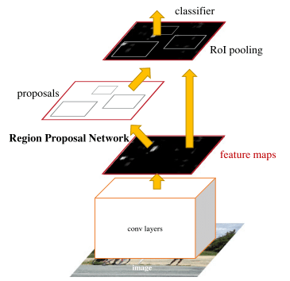
Faster R-CNN (Architecture)
The architecture of Faster R-CNN is shown in the next figure:
RPN(Region Proposal Network): For generating region proposals.
Fast R-CNN: For detecting objects in the proposed regions.
The RPN module is responsible for generating region proposals. It applies the concept of attention in neural networks, so it guides the Fast R-CNN detection module to where to look for objects in the image.

Slide 21
Implementation
SSD

Slide 22
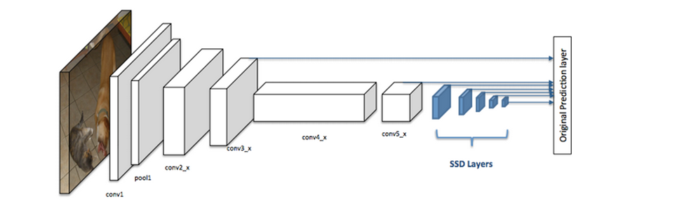
SSD (Architecture)
SSD has two components:
a backbone model and SSD head.
The backbone results in a 256 7x7 feature maps for an input image. We will explain what feature and feature map are later on. The SSD head is just one or more convolutional layers added to this backbone and the outputs are interpreted as the bounding boxes and classes of objects in the spatial location of the final layers activations.

Slide 23
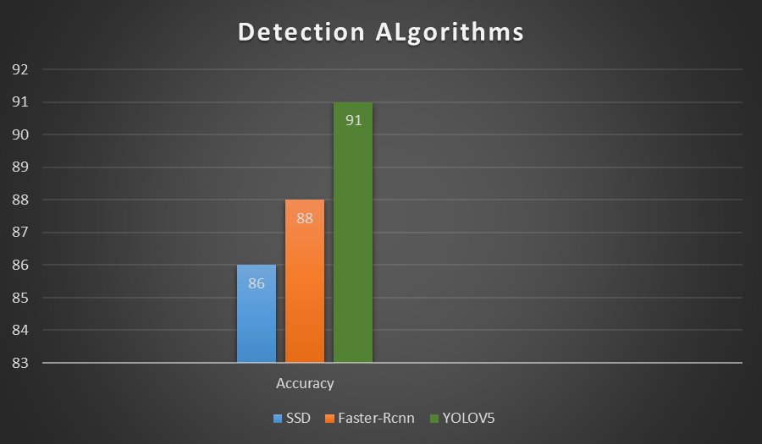
Results
Based on this we select yolo model.

Slide 24
Implementation
Desktop Application(Covid-19 Challenge)

Slide 25
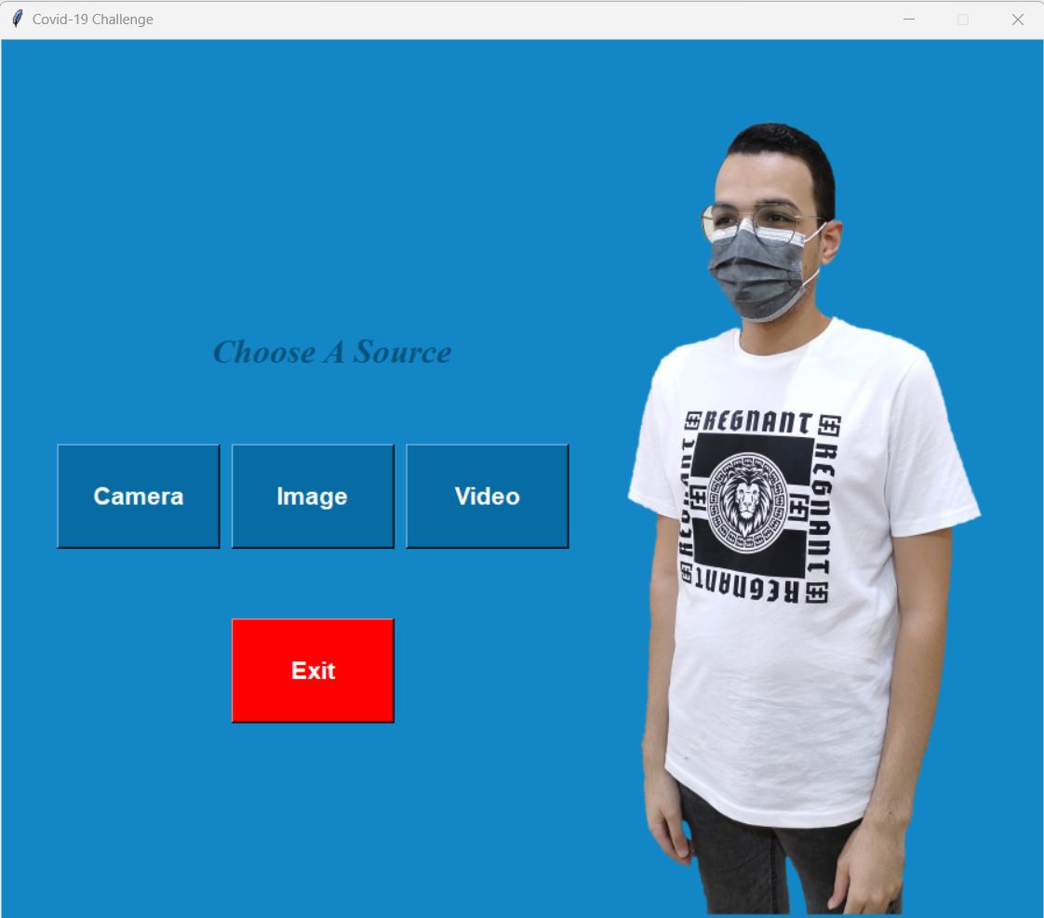
GUI man window Covid-19 Challenge
The user can choose to use live camera or local videos or images.

Slide 26
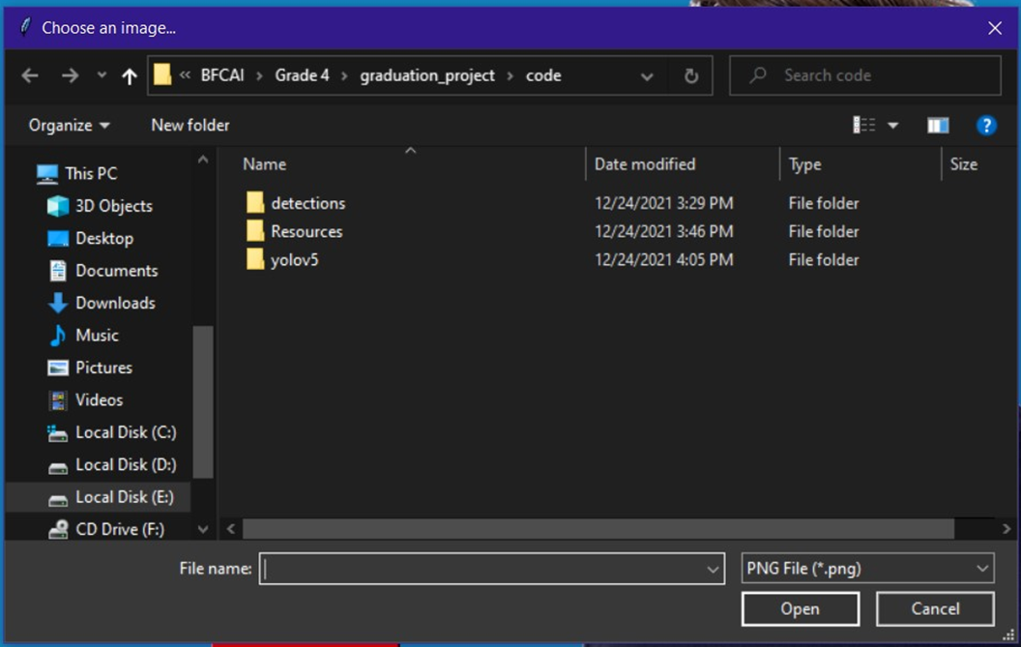
Open Image Button
After clicking the image button a file dialog pops up to enable user to choose an image.

Slide 27
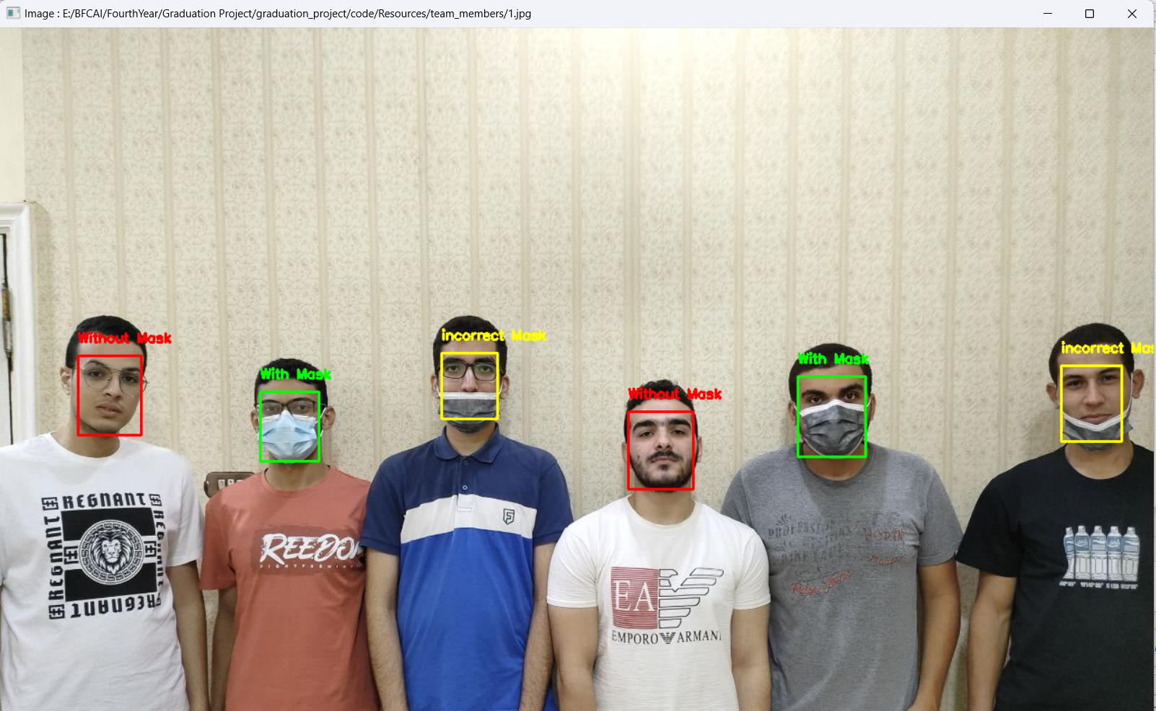
Result image
After processing the image in the model the app shows the result and saves the result at the detections folder.

Slide 28
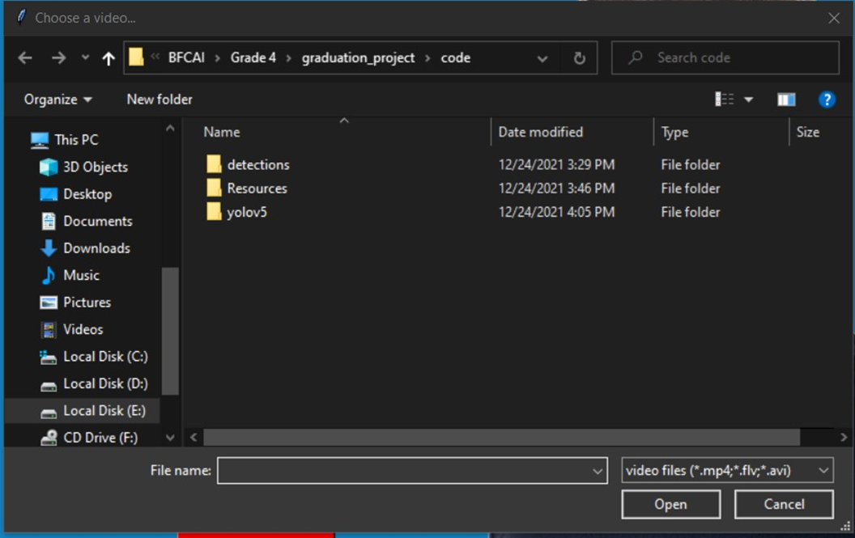
Open video Button
After clicking the video button a file dialog pops up to enable user to choose a local video.

Slide 29
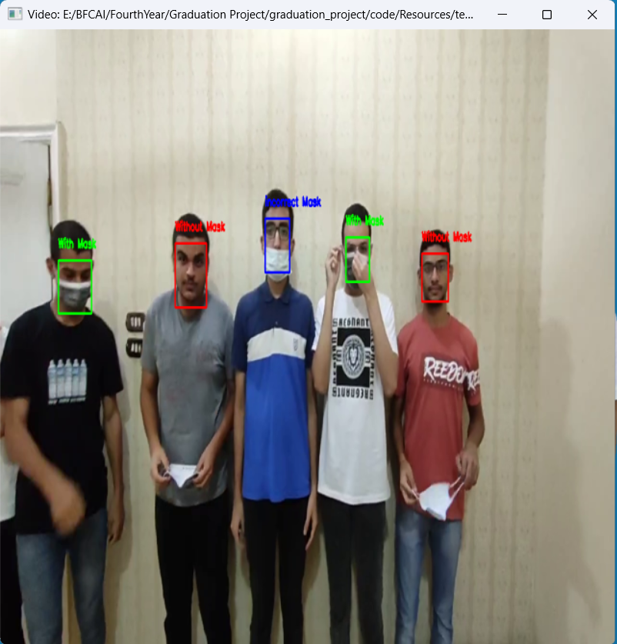
Result video
After processing the video frame by frame in the model the app shows the result and saves the result in the detections folder.

Slide 30
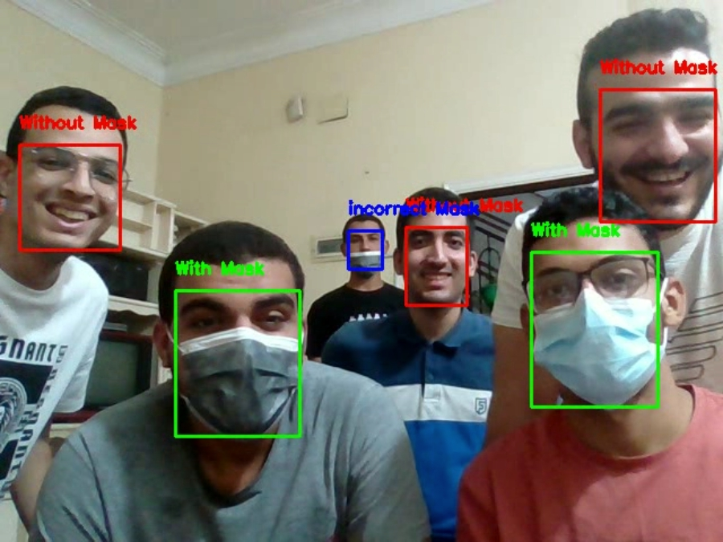
Result Web cam
After processing the Web cam input frame by frame in the model the app shows the result and saves the result in the detections folder.

Slide 31
Conclusion
Precautionary measures detection system to face the spread of infectious diseases is a detection application for the faculties of the departments which was developed to help in detecting the people who wear mask and don’t wear it and wear it in wrong way that help for preventing spread of COVID-19 virus and other viruses when applying the precautionary measures.
It is also helpful application for crowded places that requires that all people wearing their own mask.

Slide 32
future work
Developing the application and make it better that can be used in wider places
Increase the dataset to increase the performance of the application.
Develop it on specialized devices that make it useful in places prone to mixing.
Adding more advanced options in the application that make it easier to use and more efficient.
Enable users to interact with the application without learning computer science and no need to learn how to deal with software.

Slide 33
Tools & libraries
Kaggle
Roboflow
Google Colab
PyCharm
Python 3.10
Open CV
TKINTER
Torch
OS
NumPy

Slide 34
References
[1] C. Szegedy et al., “Going Deeper with Convolutions,” 2015, doi: 10.1002/jctb.4820
[2] Girshick, Ross. "Fast r-cnn." Proceedings of the IEEE international conference on computer vision. 2015.
[3] Zeiler, Matthew D., and Rob Fergus. "Visualizing and understanding convolutional networks." In European conference on computer vision, pp. 818-833. springer, Cham, 2014.

Slide 35
References
[4] Jump up to:ª ^{b} Prechelt, Lutz; Geneviève B. Orr (2012-01-01). "Early Stopping — But When?". In Grégoire Montavon; Klaus-Robert Müller (eds.). Neural Networks: Tricks of the Trade. Lecture Notes in Computer Science. Springer Berlin Heidelberg. pp. 53–67. doi:10.1007/978-3-642-35289-8_5. ISBN 978-3-642-35289-8.
[5] COVID Face Mask Detection Dataset | Kaggle
[6] ‪Dataset-F.M.D-5‏ - Google Drive

Slide 36
References
[7] Datasets - Definition, Types, Properties and Examples (byjus.com)
[8] https://labelyourdata.com/articles/what-is-dataset-in-machine-learning#what_is_a_dataset_in_machine_learning_and_why_is_it_essential_for_your_ai_model
[9] Ron Kohavi; Foster Provost (1998). "Glossary of terms". Machine Learning. 30: 271–274. doi:10.1023/A:1007411609915..
[10] Bishop, Christopher M. (2006). Pattern Recognition and Machine Learning. New York: Springer. p. vii. ISBN 0-387-31073-8. Pattern

Slide 37
السلام عليكم ورحمة الله وبركاته
Thanks

